Slide 1
BOOSTING ALGORITHM

Slide 2
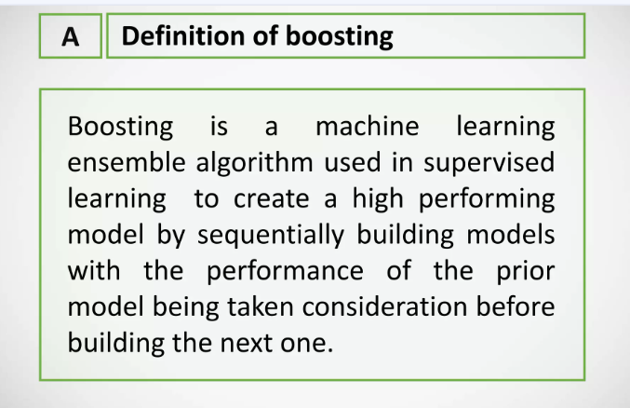

Slide 3
TYPES
ADA BOOST REGRESSOR
XG_BOOSTING
LG_BOOSTING

Slide 4
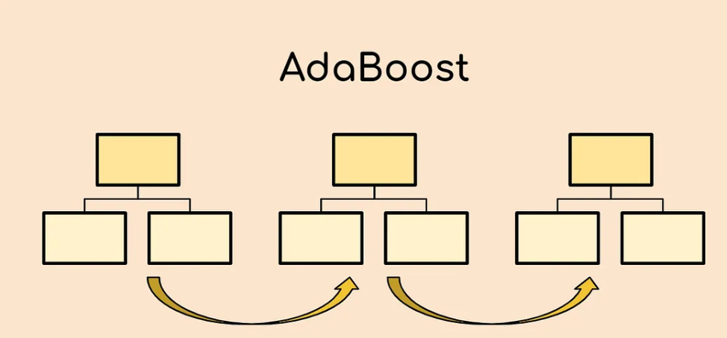
ADA BOOST REGRESSOR
It is a supervised learning algorithm that is used to classify data by combining multiple weak or base learners (e.g., decision trees) into a strong learner.
It reduce bias and variance.
We find depth for Decision tree ,adaboost takes only stumps.

Slide 5
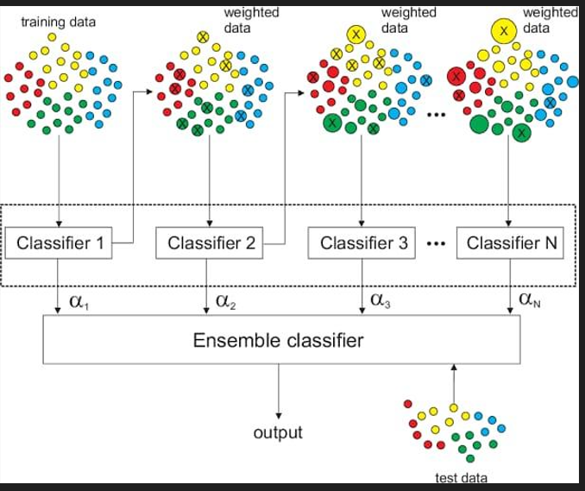

Slide 6
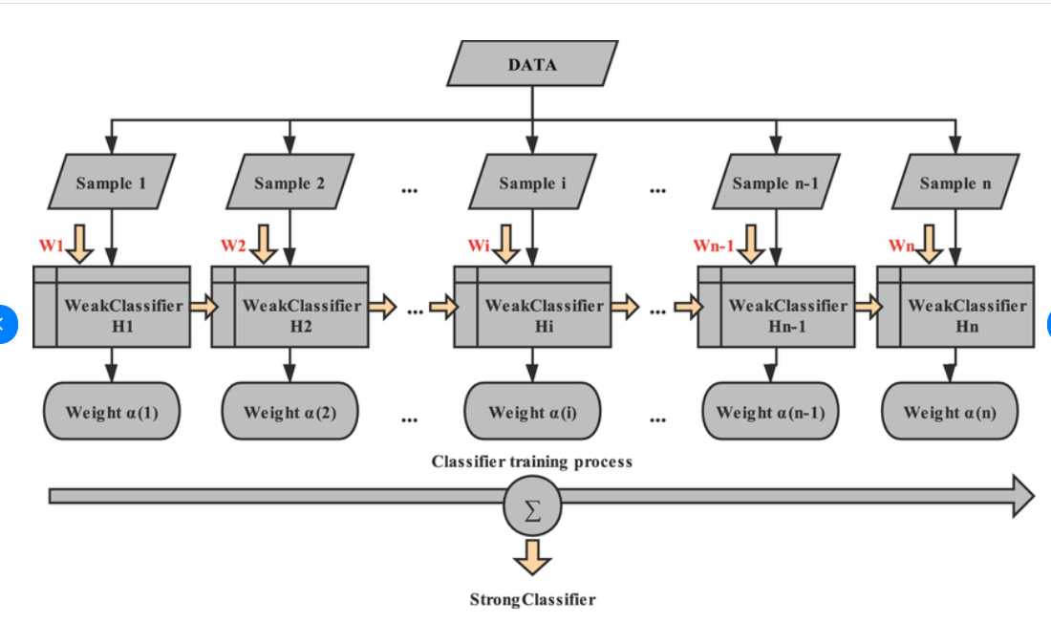

Slide 7
Advantages of ADA Booster:
High Accuracy
Boosting Performance
Simple Implementation
Less Overfitting
Disadvantages of AdaBooster:
Sensitive to Noisy Data
Slow Training
Overfitting with Complex Models
Applications of AdaBooster:
Image Recognition
Text Classification
Anomaly Detection

Slide 8
XG BOOSTING
This model is based on ‘Weak learner’
The trees are grown sequentially, with each tree learning from the mistakes of the previous tree. The final prediction is made by taking the average of the predictions from all of the trees in the ensemble.
One of the key advantages of XGBoost is its ability to handle missing data and large datasets efficiently.

Slide 9
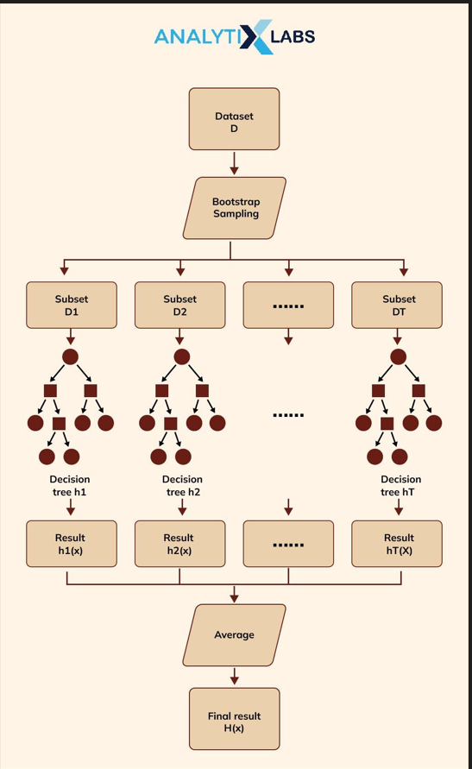

Slide 10
Advantages of XG Booster:
High Performance and Accuracy
Speed and Efficiency
Handling Missing Data
Cross-Validation
Disadvantages of XGBooster:
Resource Intensive
Interpretability
Sensitive to Noise
Applications of XGBooster:
Finance
Genomics and Bioinformatics
Recommender Systems

Slide 11
LG BOOSTING
Faster training speed and accuracy resulting from LightGBM being a histogram-based algorithm that performs bucketing of values (also requires lesser memory).
Also compatible with large and complex datasets but is much faster during training.
Support for both parallel learning and GPU learning

Slide 12
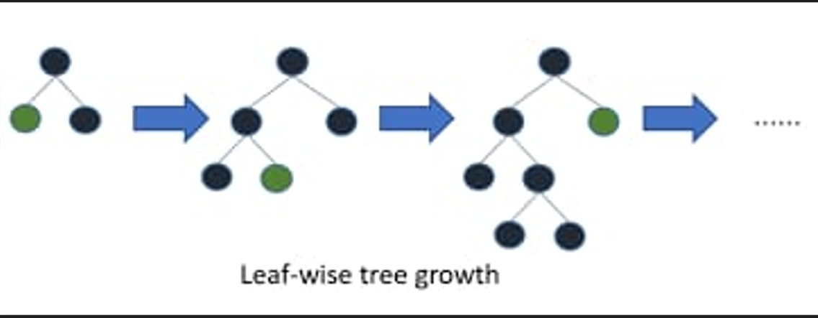

Slide 13
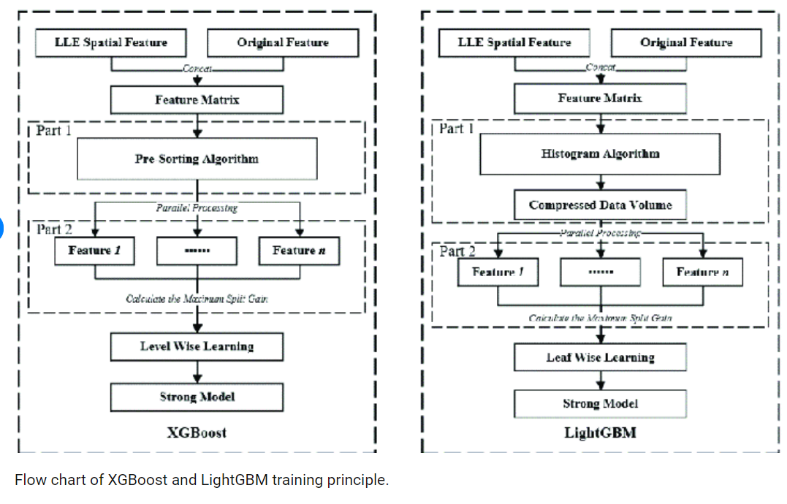

Slide 14
Advantages of lightning boost algorithm:
Faster Training Speed and Efficiency
Scalability
Accuracy
Cross-Validation
Disadvantages of lightning boost algorithm:
Sensitive to Hyperparameter
Requires Preprocessing
Not Ideal for Very Small Datasets
High Memory Usage with Large Binning:
Applications of lightning boost algorithm:
Finance -Credit scoring,fault detection
Marketting and Sales
Healthcare
Energy Consumption Forecasting

